Slide 1


Capstone Project – University Ranking

Slide 2
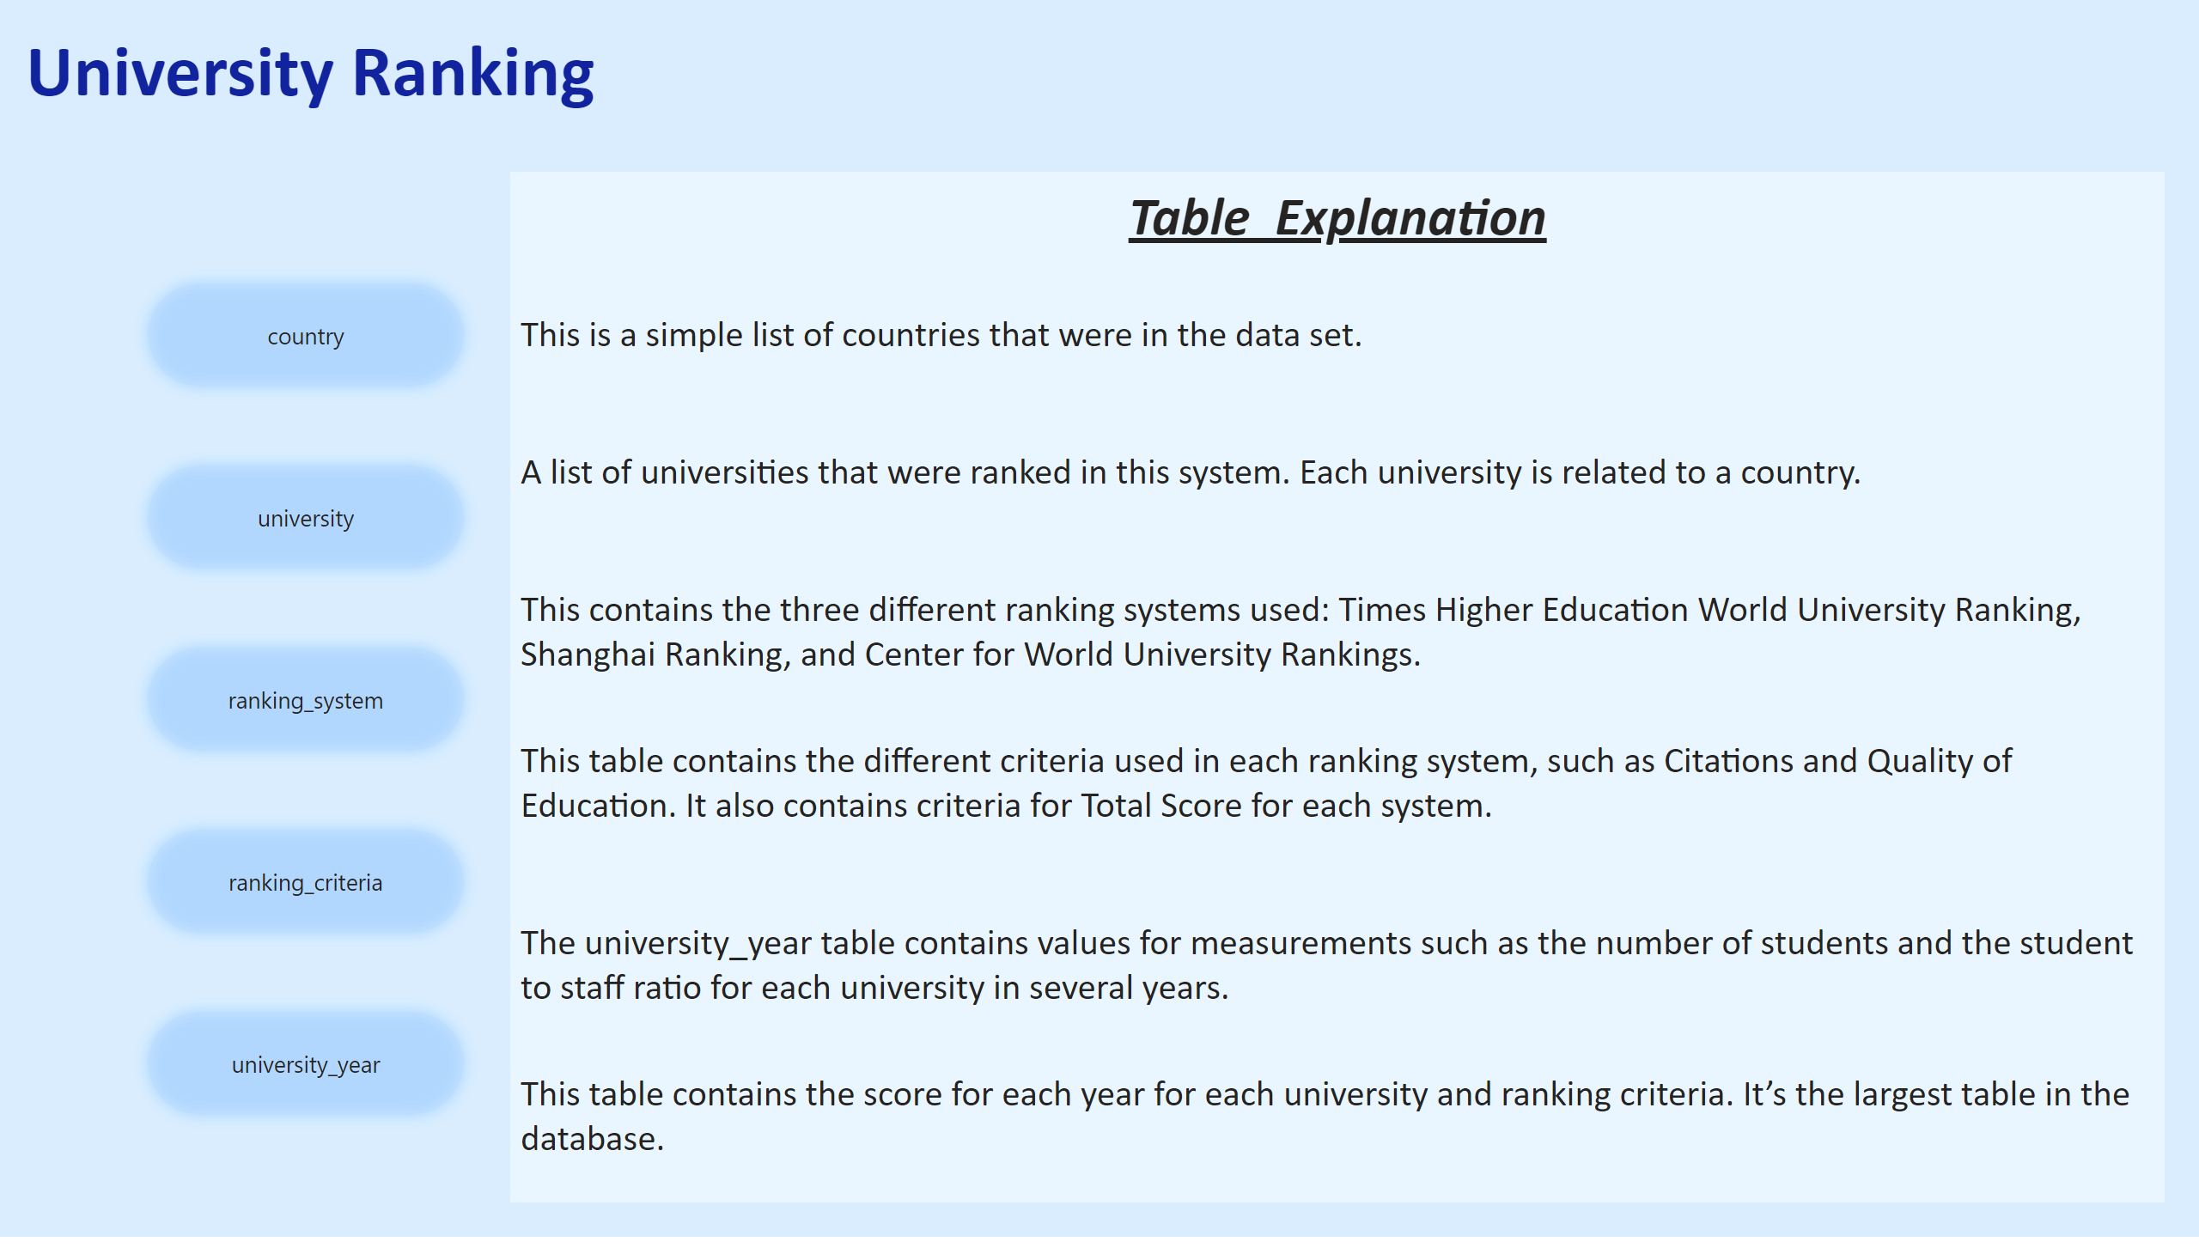
Table Explanation

Slide 3

Table Explanation
Exploring University Rankings Analysis
University rankings offer insights into higher education quality, but challenges exist:
- Variations Across Systems
- Influential Factors and Historical Trends
- Limitations and Biases Impacting Rankings

Slide 4
Table Explanation
Project Objective
Conduct a comprehensive analysis of university rankings dataset:
- Identify Patterns, Trends, and Influential Factors
- Enhance Institutional Quality and Competitiveness

Slide 5
Table Explanation
Approach:
- Source and Clean University Rankings Data
- Explore Patterns Through Visualization
- Analyze Factors Impacting Rankings
- Address Limitations and Biases

Slide 6
Table Explanation
Key Findings and Insights:
- Correlation Between Factors and Rankings
- Strategies to Mitigate Biases
- Enhancing Decision-Making in Higher Education

Slide 7
Table Explanation
The project will involve the following tasks:
Performing a comprehensive analysis of university rankings, including variations across systems,
key factors influencing rankings, historical trends, and the impact of limitations and biases on rankings.
Deriving meaningful conclusions and recommendations for improving ranking methodologies.
Compiling analysis results, conclusions, and recommendations for stakeholders.
The success of the project will be measured by the following metrics:
The quality of the analysis
The relevance of the insights
The impact of the recommendations
This project is significant because it has the potential to improve the quality and
competitiveness of higher education institutions worldwide. By understanding the factors that
influence university rankings, institutions can better position themselves to succeed in the global marketplace.

Slide 8
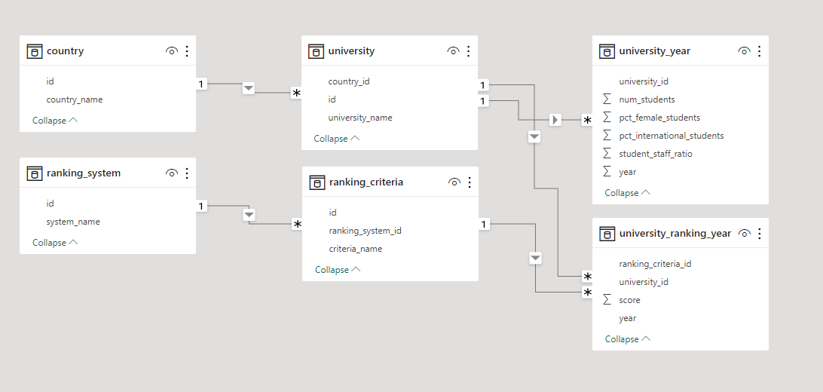
ER Diagram

Slide 9
Power BI Problem Statements

Slide 10
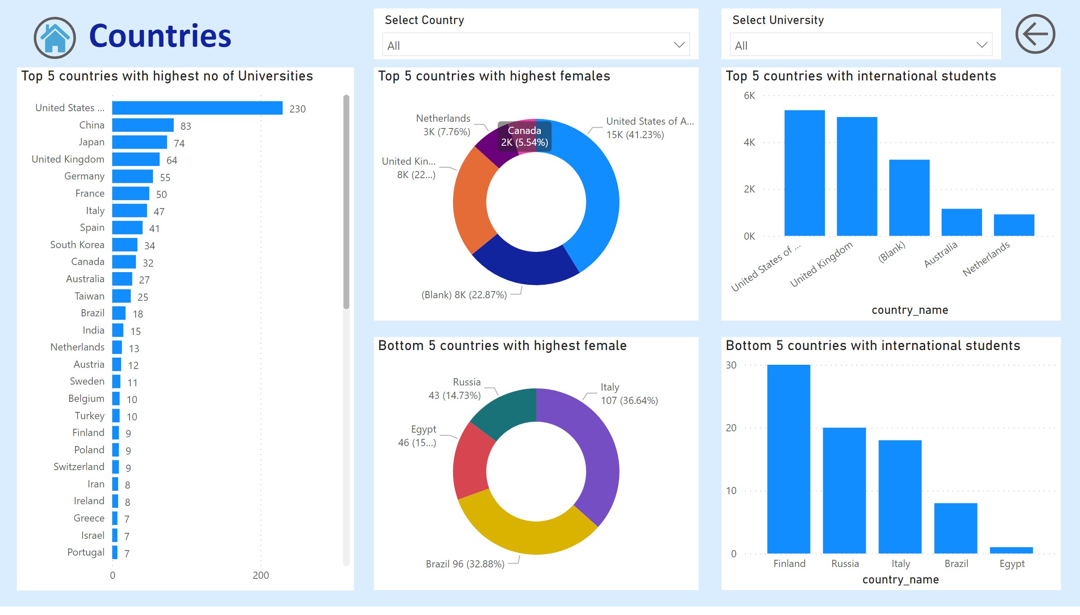
country

Slide 11
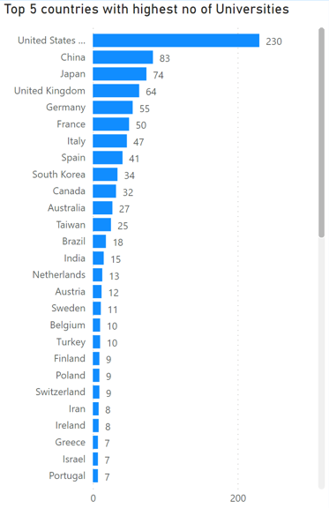
How many universities are there in each country?
Gleaning from the Country Report, it becomes apparent that nations such as the USA, China, and Japan boast the highest number of universities. Conversely, countries like Uganda, the UAE, and Uruguay exhibit a comparatively lower count of universities.

Slide 12
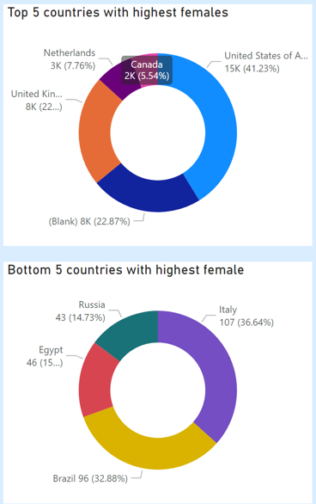
Which country has the highest number of female students enrolled in universities?
Exploring Female Student Enrolment Across Countries
Enrolment Disparities:
Leading Countries: USA, UK, and Netherlands
Lagging Countries: Italy, Brazil, Egypt
Challenges and Data Enhancement:
Limited Data for Many Universities
Dataset Update for Enhanced Accuracy

Slide 13
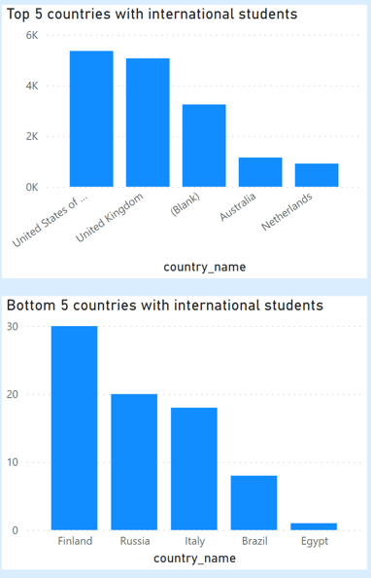
What is the distribution of international students across different countries?
USA , UK Australia, Netherlands have highest no of international students Finland Russia Italy have lowest no of international student

Slide 14
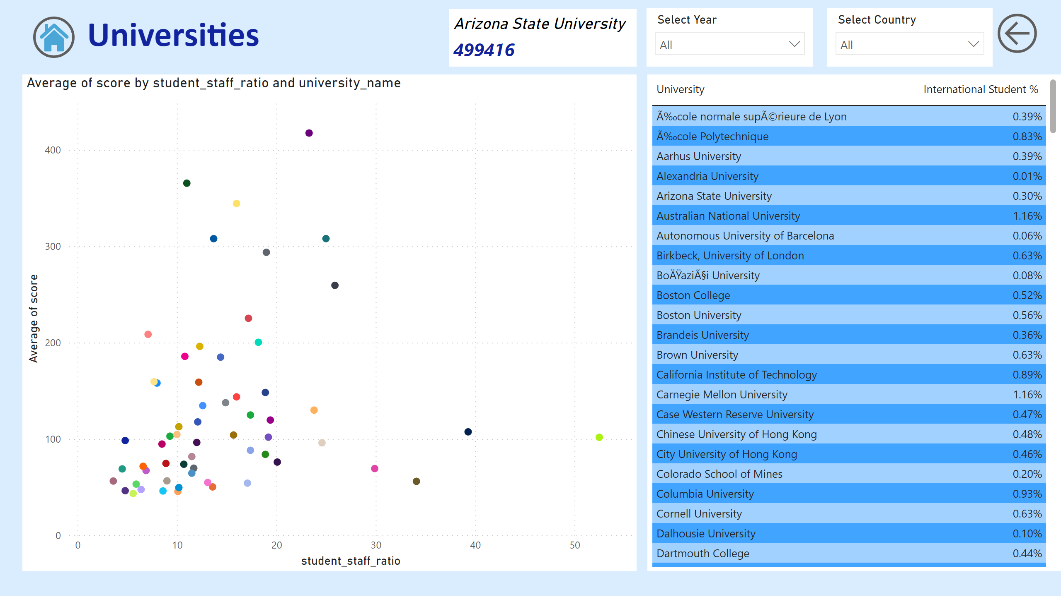
university

Slide 15
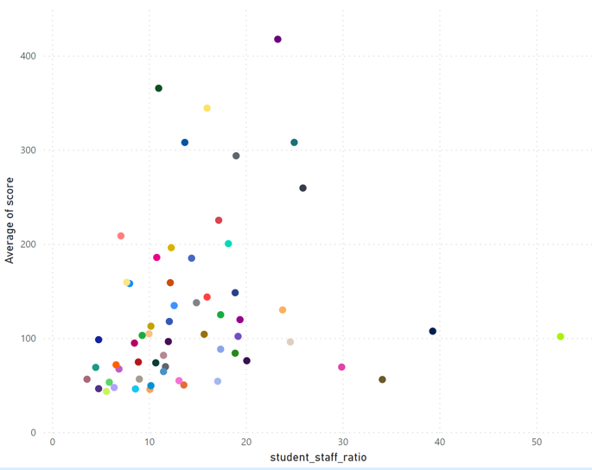
Is there a correlation between a university's ranking and its student-staff ratio?
Upon analysing the correlation between the ranking system and its student-staff ratio, it became evident that there is no immediate connection between these two metrics. A direct relationship between these key performance indicators (KPIs) is necessary in order to create the intended visualization.
What is the corelation between average score and student_staff ratio for universities
Upon analysing the correlation between the student staff ratio and the average score, most of the universities have average score less than 200 and student_staff ratio 20

Slide 16

Which university has the highest number of students?
Using card visual we can see Arizona State University have the highest no of students

Slide 17
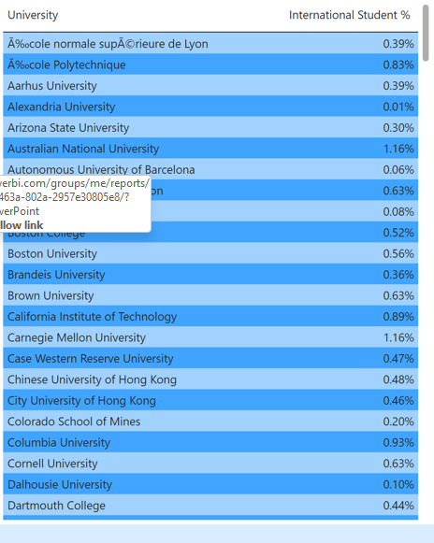
How does the percentage of international students vary across different universities?
We have created Table to show the percentage of international students for each universities we can filter data using slicer and other visual

Slide 18
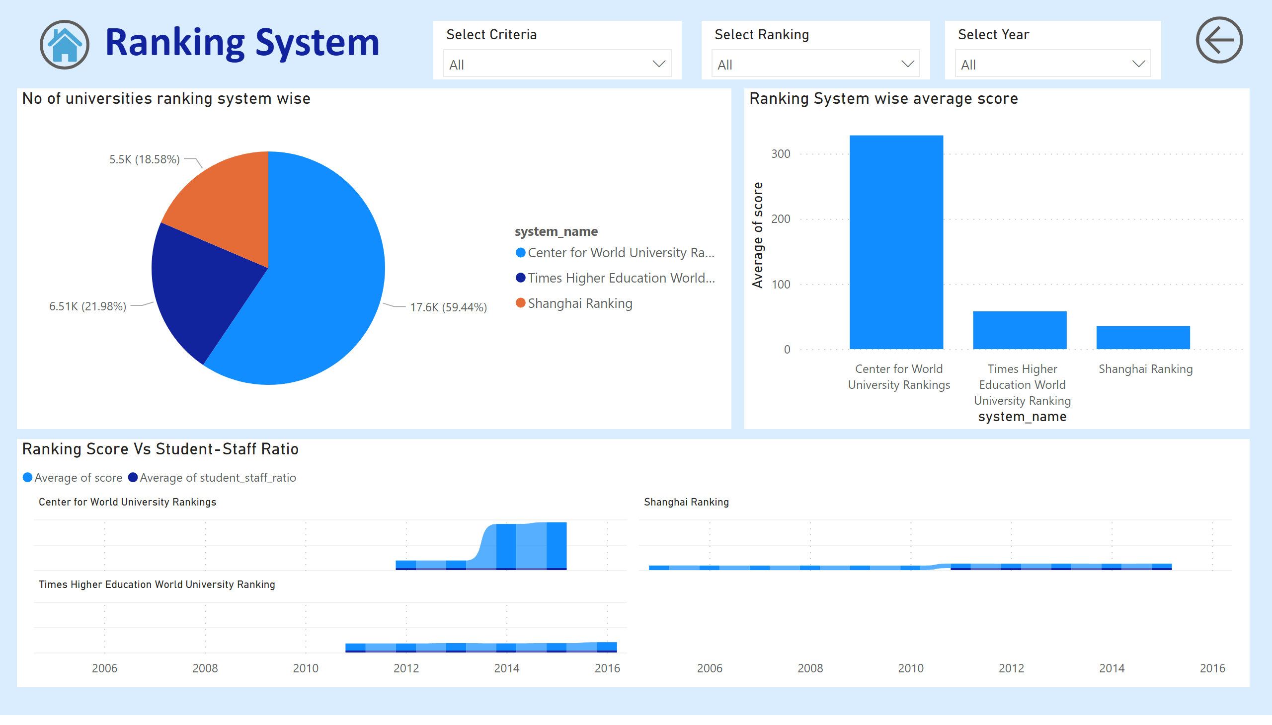
ranking_system

Slide 19
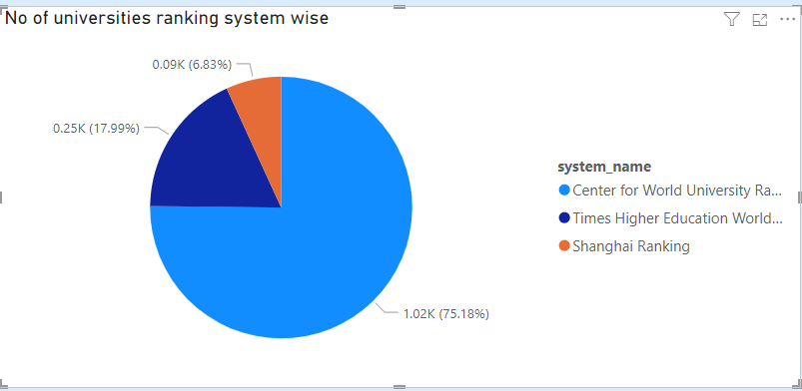
How many universities are ranked by each ranking system?
From the above pie chart, we can clearly see most of the universities are ranked under Center for World University Ranking system

Slide 20
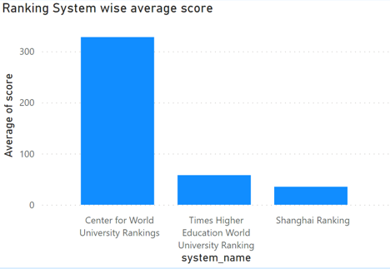
What is the average score for each ranking system
From the visual we can get average score for different ranking system.

Slide 21
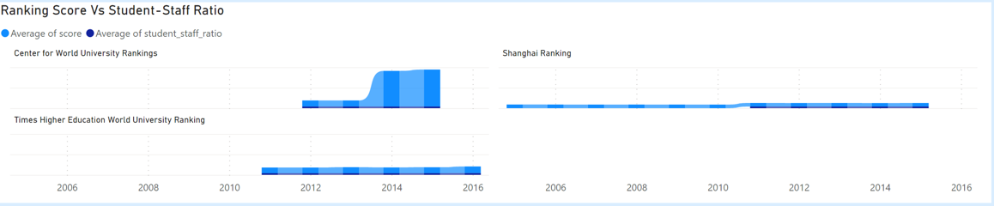
What is the corelation between average score and student_staff ratio for universities for each ranking system
From the visual we can get the relationship between average score and average of student staff ratio for different ranking system.

Slide 22
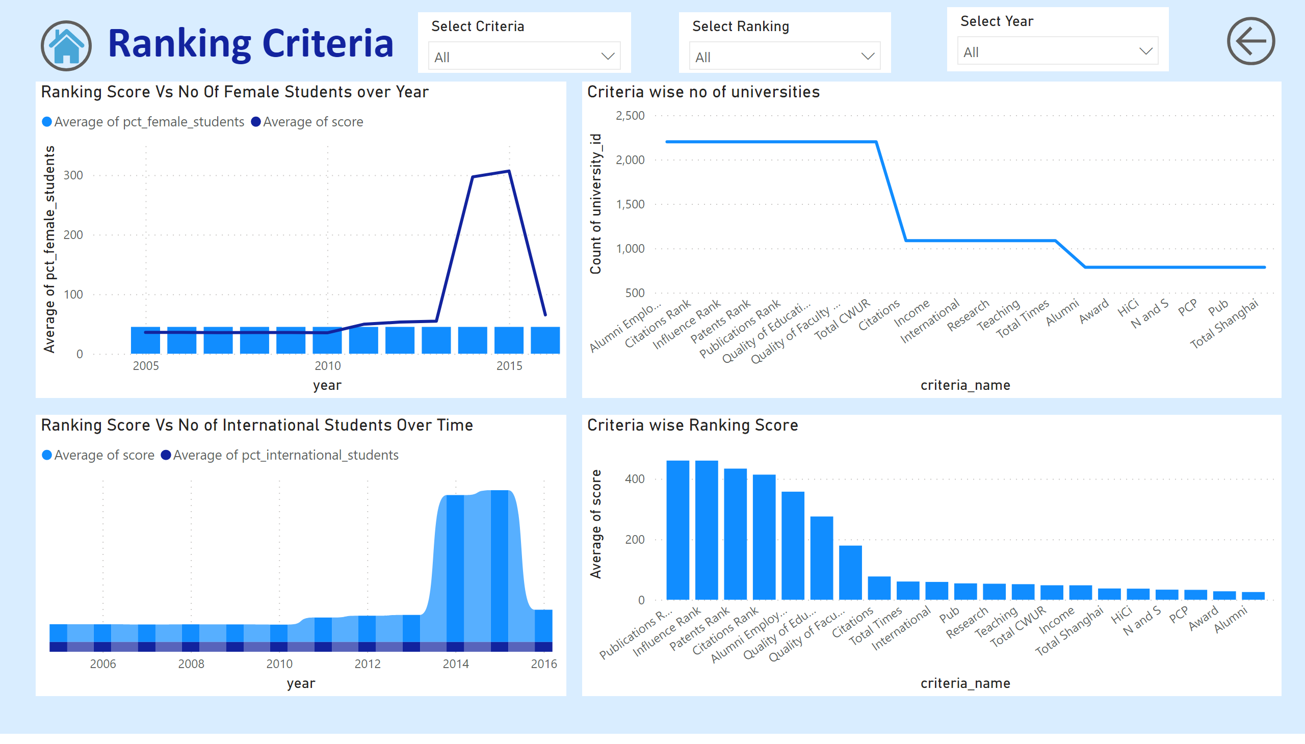
ranking_criteria

Slide 23
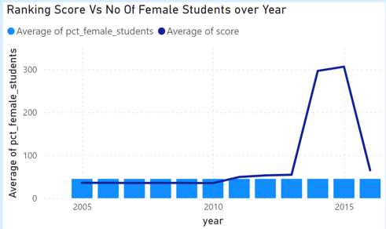
How does the percentage of female students impact a university's ranking?
From the visual we can see relation between no of female student and average score for the universities over time

Slide 24
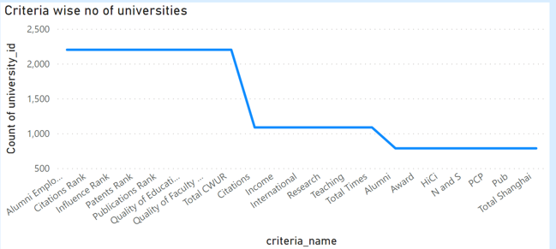
What are the most important criteria considered by ranking systems?
From the given visual we can understand Alumni Employment, Citations Ranks and Influence Rank are most crucial criteria for ranking system.

Slide 25
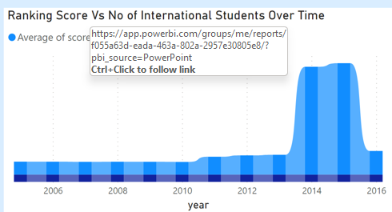
Is there a correlation between a university's score and the number of international students?
From the visual we can analyse the relation between no international student and average score over time

Slide 26
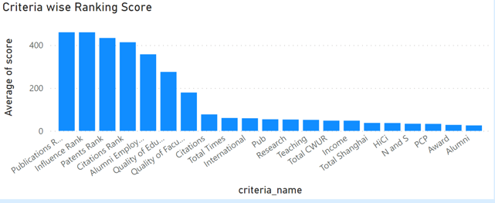
What is the average score for each criteria of the ranking system ?
From the visual we can understand Publications Ranking got the highest average ranking among all criteria’s

Slide 27
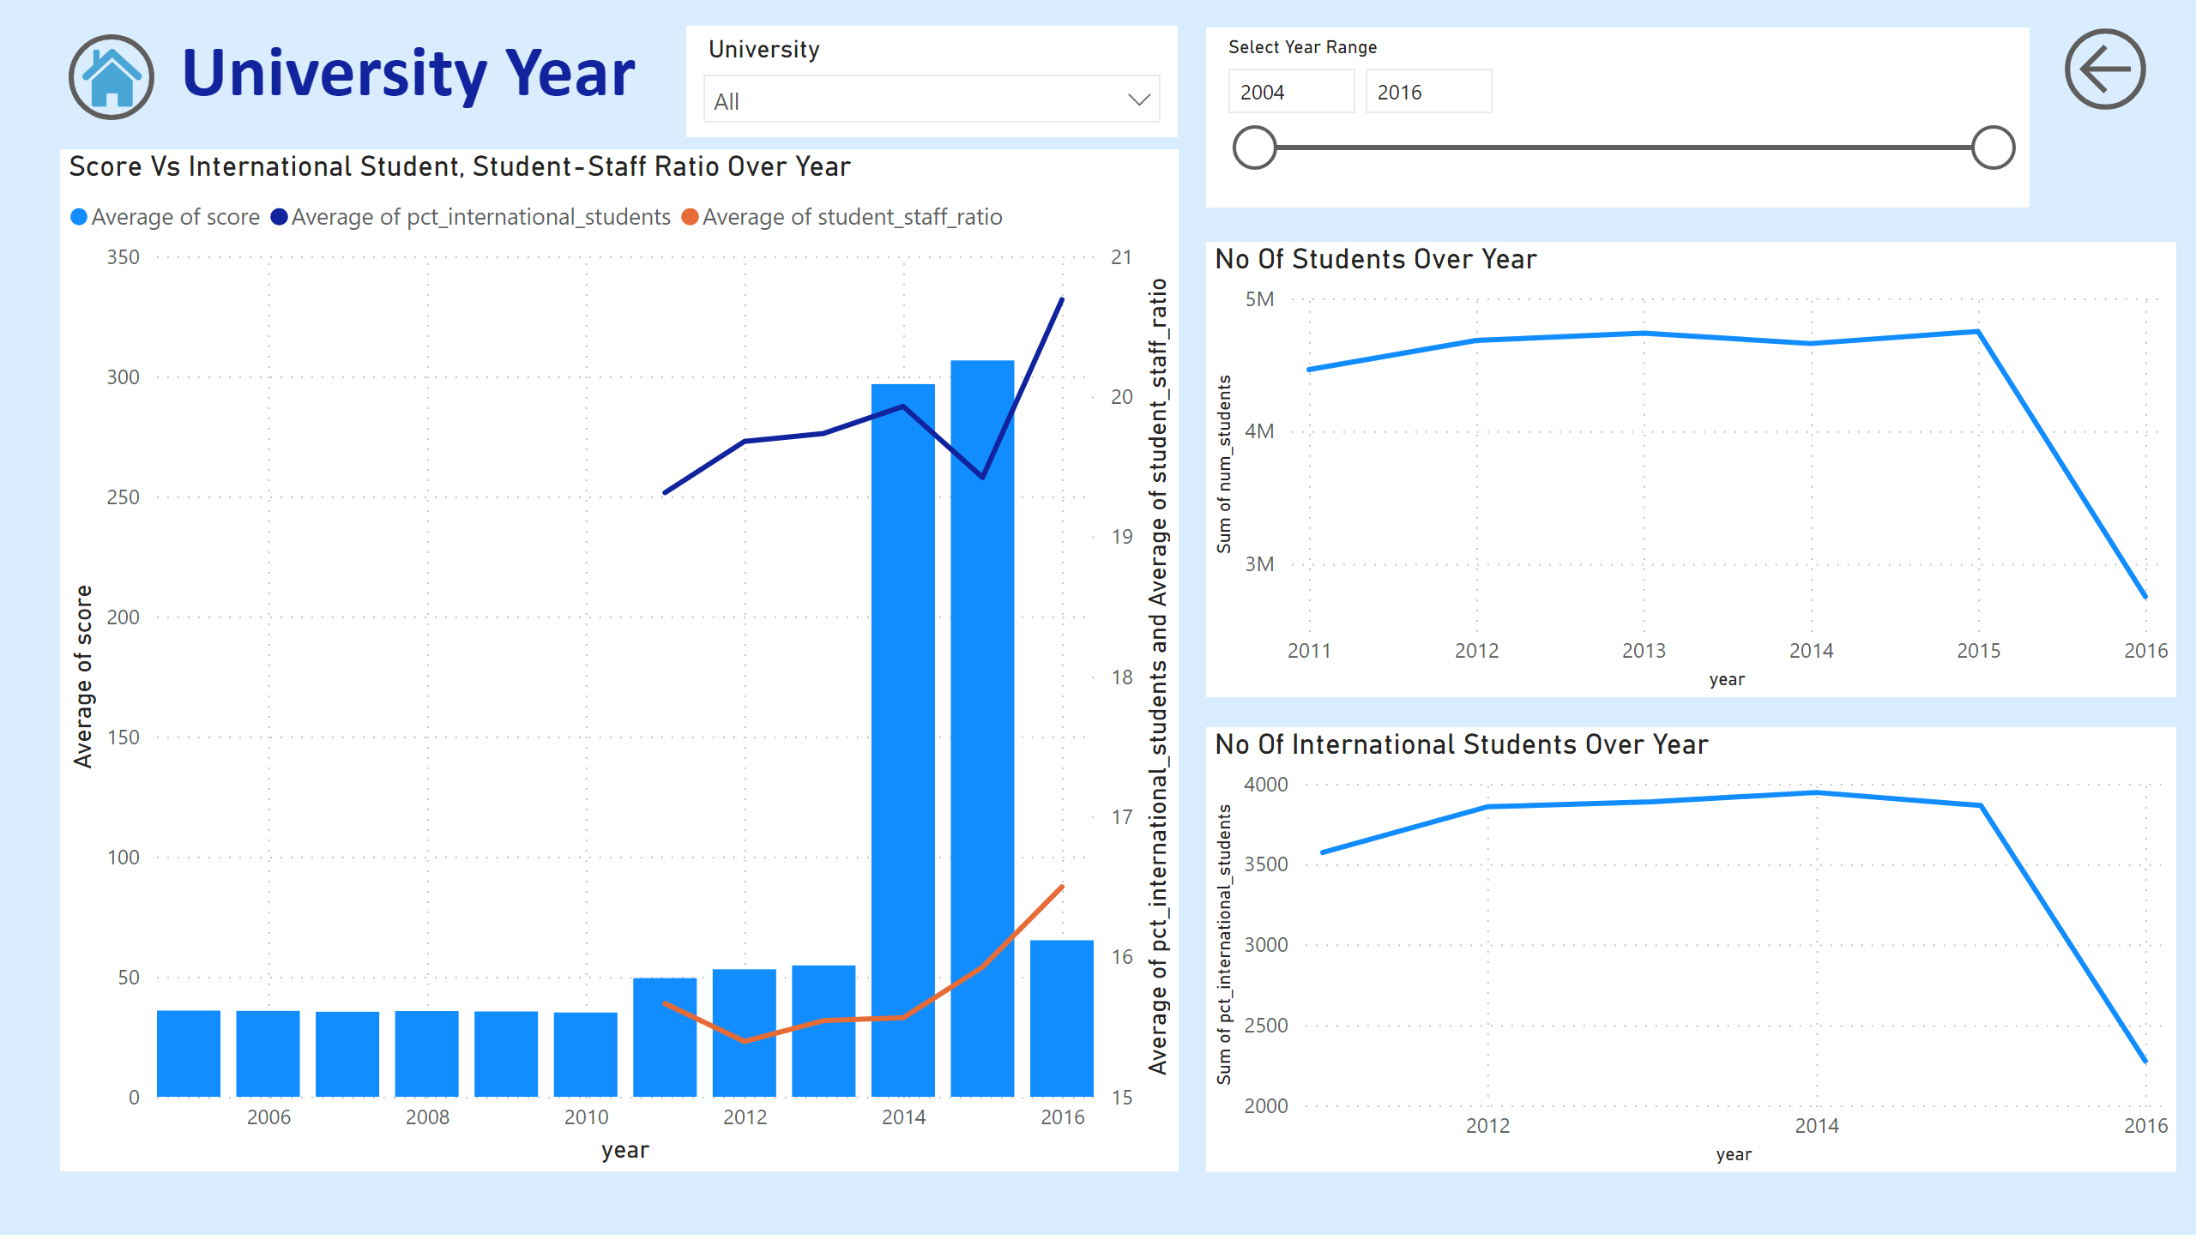
university_year

Slide 28
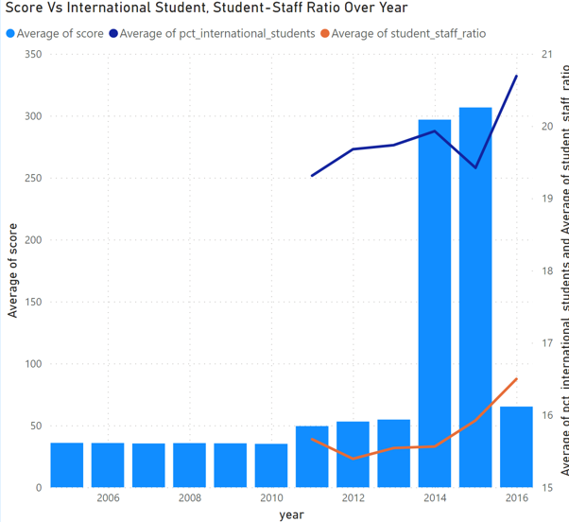
Is there a correlation between a university's ranking score and the student-staff ratio over the years?
We have created dual axis visual to show relationship of average score with average no of international students and average student staff ratio.

Slide 29
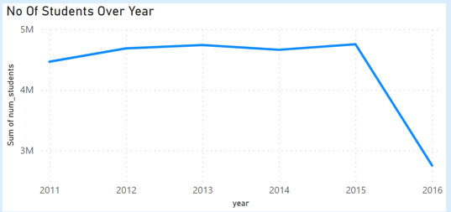
How does the number of students in universities change over time?
We can clearly see there is drop in no of students from year 2015 to 2016. We can further analyse the reason for same.

Slide 30
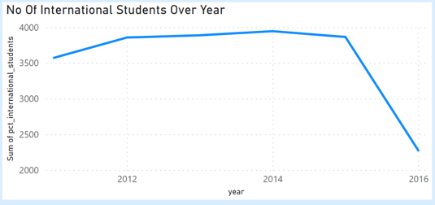
How does the number international students in universities change over time?
We can clearly see there is drop in no of international students from year 2015 to 2016. We can further analyse the reason for same.

Slide 31
EDA Problem Statements

Slide 32
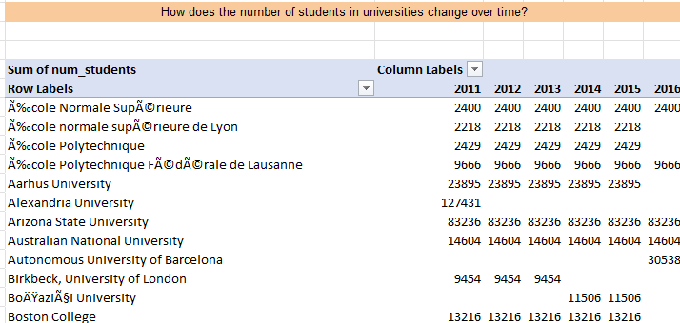
We can see no of students changed over time for each universitas

Slide 33
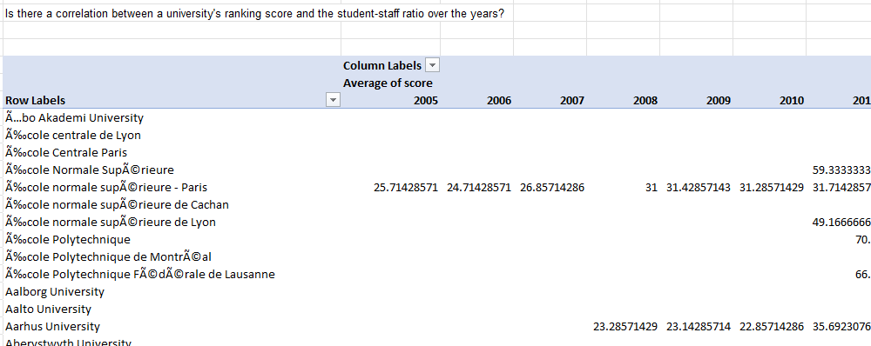
We can’t see any direct correlation between these two measures

Slide 34
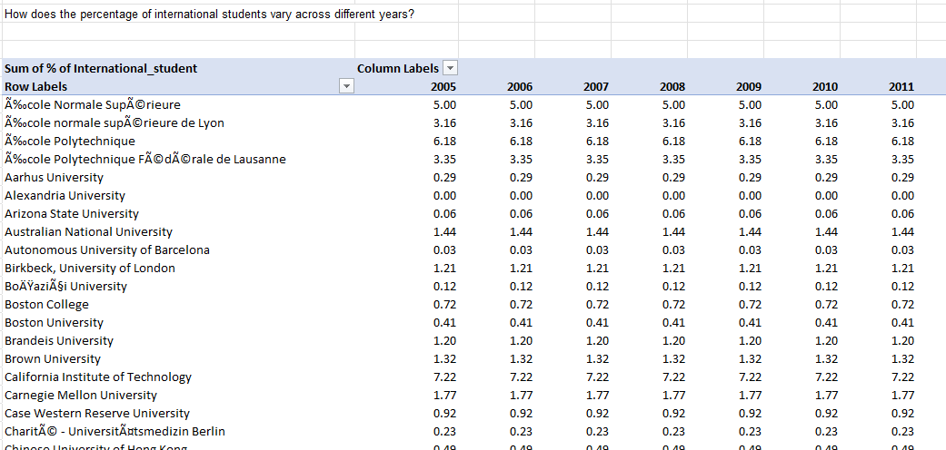
We have already visualise same in Power BI we can see detailed info for same here as table.

Slide 35
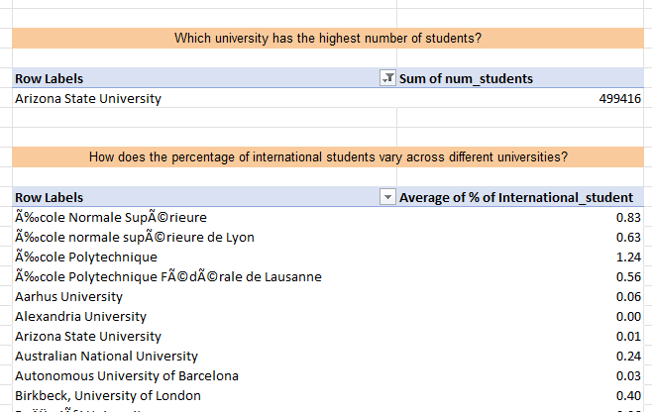
We can see Arizona State University have the Highest no of Students.

Slide 36
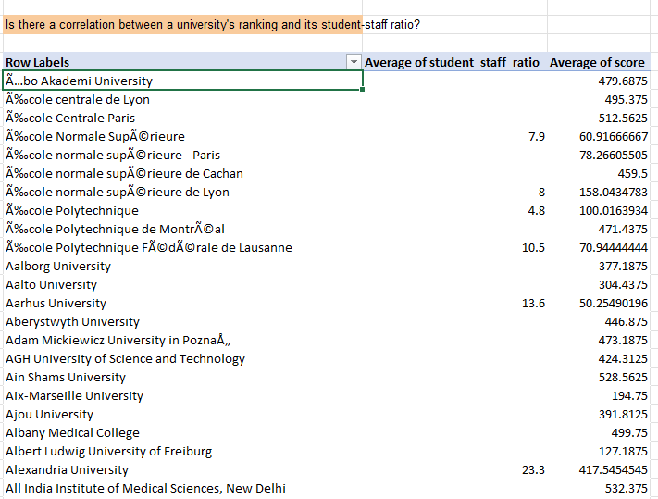
We can see any direct corelation between two measures

Slide 37
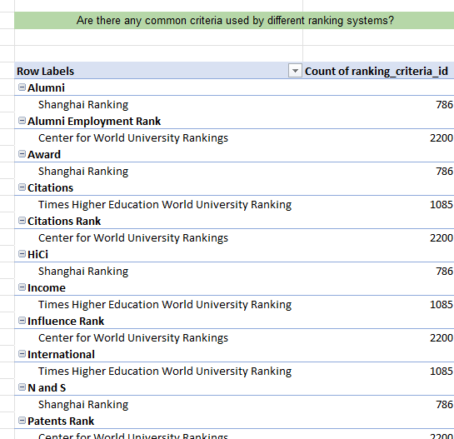
There is no common criteria used by different ranking system

Slide 38
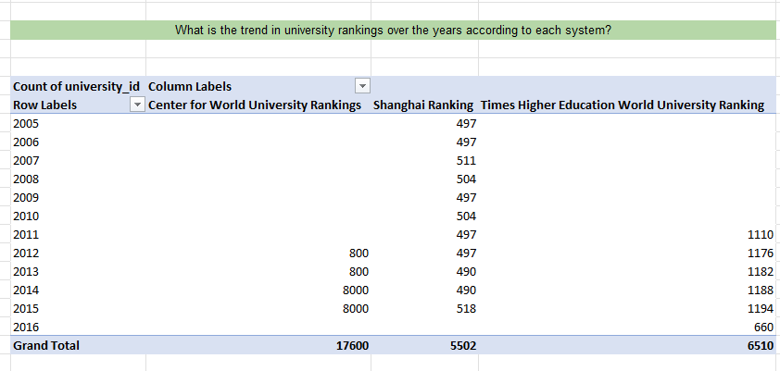
In this visual we can see no of universities ranked under each ranking system.

Slide 39
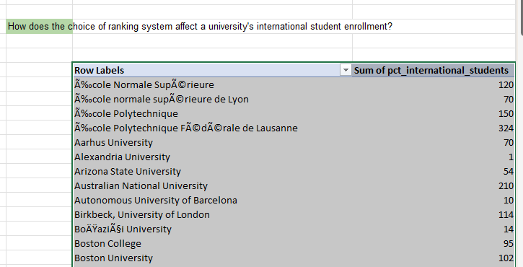
As we don’t have direct relation among ranking system and no of international student enrolled. We are checking no of international students for each university

Slide 40
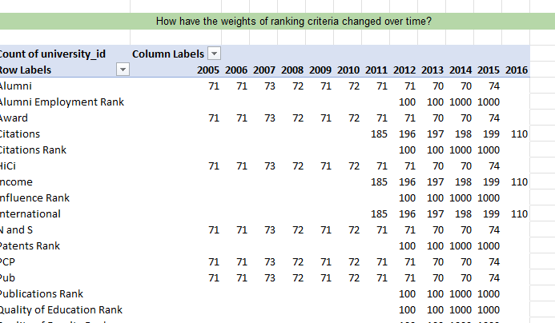
As we don’t have direct relation among given measure and not enough data to analyse the weight of ranking criteria over time.

Slide 41
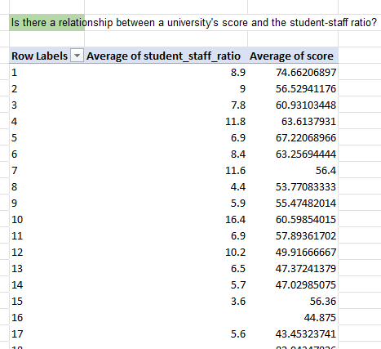
We have visualised same in power bi here we can see the detailed values for same.

Slide 42
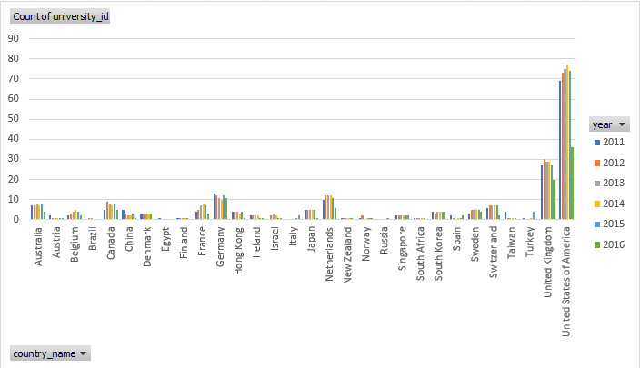
From the above visual we can see no of universities in each country over time

Slide 43
University rankings analysis can provide valuable insights for prospective students, researchers, and academic institutions to make informed decisions. By understanding the factors that influence university rankings, individuals and institutions can make better choices about where to study or work. Understanding ranking criteria can help institutions identify areas for improvement. By understanding what is important to ranking organizations, institutions can focus their efforts on those areas to improve their ranking. Analysis of university rankings can allow policymakers to assess the effectiveness of ranking systems. By understanding how rankings are calculated, policymakers can make sure that they are fair and accurate. Historical analysis of university rankings can identify trends for benchmarking and strategic planning in higher education. By understanding how rankings have changed over time, institutions can identify areas where they need to improve to stay competitive. Analysis of university rankings can enable comparisons between institutions and data-driven decisions for improving higher education quality and competitiveness. By comparing different institutions, institutions can identify the best practices that can be adopted to improve their own performance.

